Slide 1
Security Trends
Attacks and Services
Prepared by
T. Sree Sharmila

Slide 2
OSI Security Architecture
ITU-T (International Telecom Union – Telecom Standardization Sector recommends X.800Security Architecture for OSI, defines a systematic approach.
This is useful for managers to organize the task of providing security.
This focuses on security services, mechanisms and attacks.

Slide 3
Services, Mechanisms, Attacks
need systematic way to define requirements
consider three aspects of information security:
  security attack
  security mechanism
  security service
consider in reverse order

Slide 4
Security Service
  is something that enhances the security of the data processing systems and the information transfers of an organization
  intended to counter security attacks
  make use of one or more security mechanisms to provide the service
  replicate functions normally associated with physical documents
    eg have signatures, dates; need protection from disclosure, tampering, or destruction; be notarized or witnessed; be recorded or licensed

Slide 5
Security Mechanism
a mechanism that is designed to detect, prevent, or recover from a security attack
no single mechanism that will support all functions required
however one particular element underlies many of the security mechanisms in use: cryptographic techniques
Notes:
Cryptography is a foundation to support all the functions.
Technically the most difficult part.

Slide 6
Security Attack
any action that compromises the security of information owned by an organization
information security is about how to prevent attacks, or failing that, to detect attacks on information-based systems
have a wide range of attacks
can focus of generic types of attacks
note: often threat & attack mean same

Slide 7
OSI Security Architecture
ITU-T X.800 Security Architecture for OSI
defines a systematic way of defining and providing security requirements
for us it provides a useful, if abstract, overview of concepts we will study
Notes:
ITU: int'l telecommunication Union
T: telecomm. standard section
OSI: open systems interconnection
a framework, the course is more focused, but the key techniques can be used in a much broader context

Slide 8
Security Services
X.800 defines it as: a service provided by a protocol layer of communicating open systems, which ensures adequate security of the systems or of data transfers
RFC 2828 defines it as: a processing or communication service provided by a system to give a specific kind of protection to system resources
X.800 defines it in 5 major categories

Slide 9
Security Services (X.800)
Authentication - assurance that the communicating entity is the one claimed
Access Control - prevention of the unauthorized use of a resource
Data Confidentiality –protection of data from unauthorized disclosure
Data Integrity - assurance that data received is as sent by an authorized entity
Non-Repudiation - protection against denial by one of the parties in a communication
Notes:
See Table 1.4 for details of the 5 Security Service categories and the 14 specific services.

Slide 10
Security Mechanisms (X.800)
specific security mechanisms:
  encipherment, digital signatures, access controls, data integrity, authentication exchange, traffic padding, routing control, notarization
pervasive security mechanisms:
  trusted functionality, security labels, event detection, security audit trails, security recovery
Notes:
Specific: may be incorporated into the appropriate protocol layer
pervasive: not specific to any particular OSI security service or protocol layer
see Table 1.5 for details of these mechanisms, and Table 1.6 for the relationship between services and mechanisms.
The “specific security mechanisms” are protocol layer specific, whilst the “pervasive security mechanisms” are not.
Will meet some of these mechanisms in much greater detail later.

Slide 11
Classify Security Attacks as
passive attacks - eavesdropping on, or monitoring of, transmissions to:
  obtain message contents, or
  monitor traffic flows
active attacks – modification of data stream to:
  masquerade of one entity as some other
  replay previous messages
  modify messages in transit
  denial of service

Slide 12

Passive Attacks
Reading contents of messages
Also called eavesdropping
Difficult to detect passive attacks
Defense: to prevent their success

Slide 13
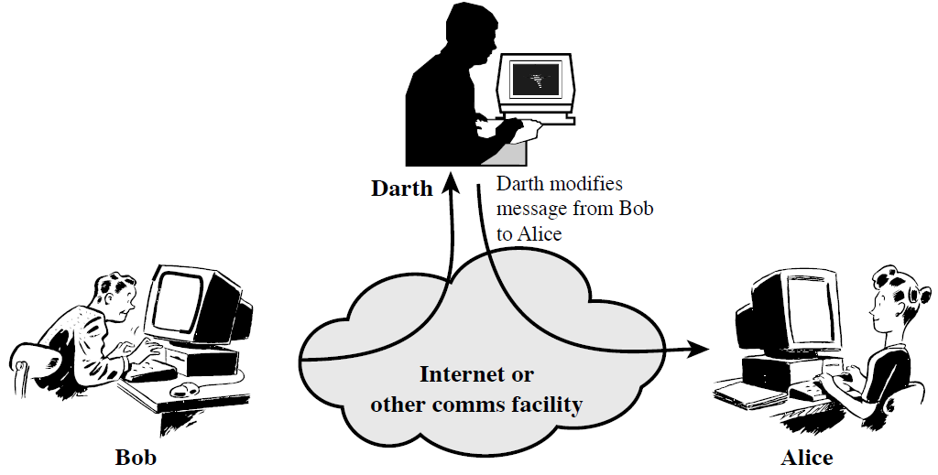
Active Attacks
Modification or creation of messages (by attackers)
Four categories: modification of messages, replay, masquerade, denial of service
Easy to detect but difficult to prevent
Defense: detect attacks and recover from damages

Slide 14
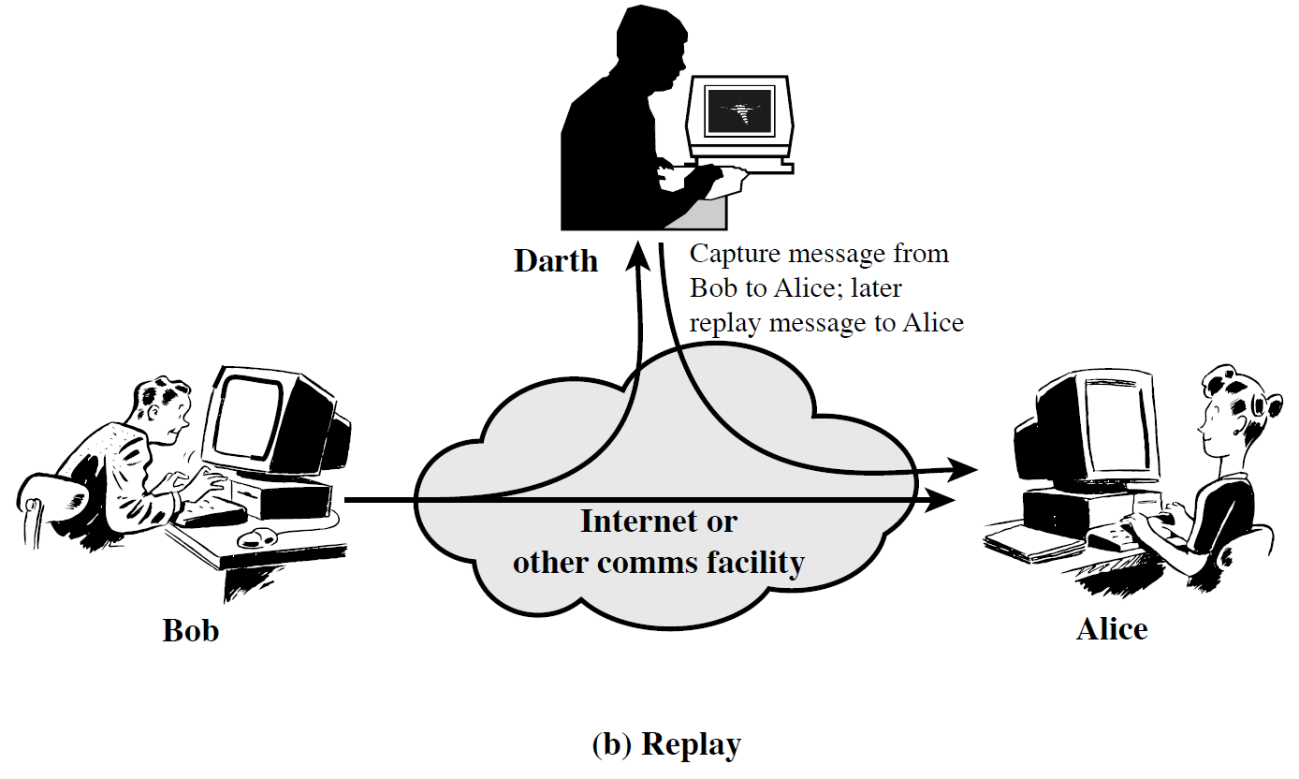

Slide 15


Slide 16
